Slide 1
Survey Lifecycle
Survey Planning
Survey Design
Survey Distribution
Survey Analysis

Slide 2
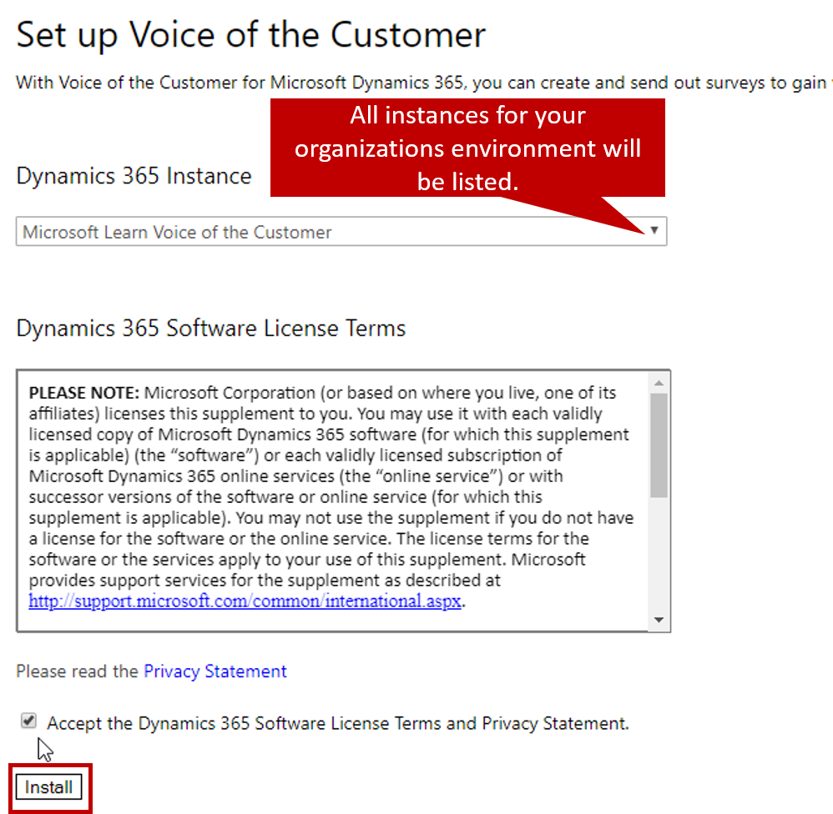
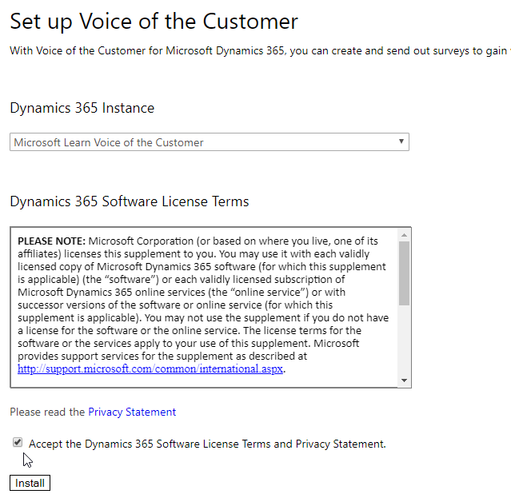
All instances for your organizations environment will be listed.

Slide 3
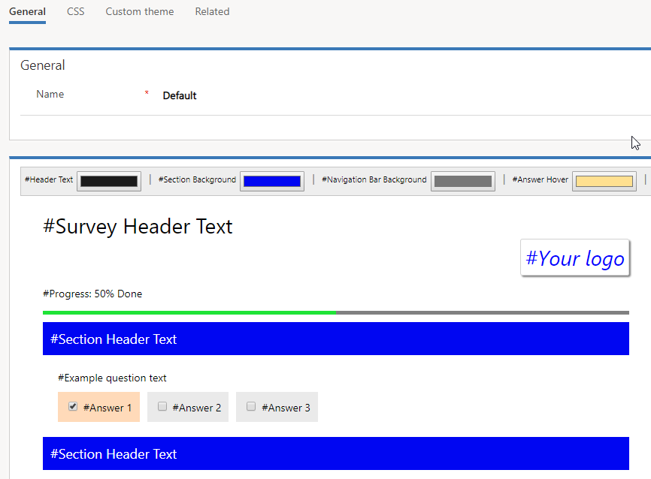

Slide 4
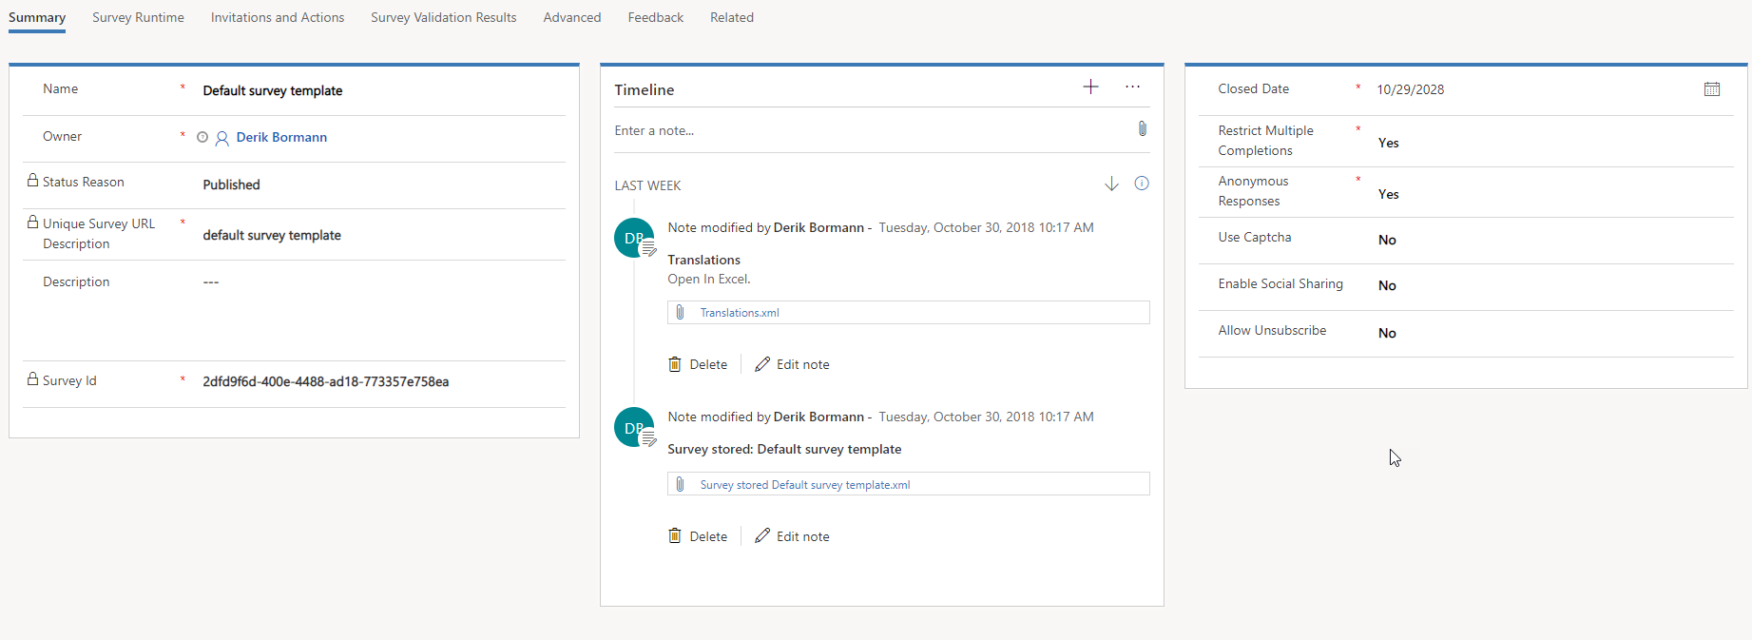
Defines survey name, status, unique survey URL description, and description
Lets you define items such as survey close date, anonymous responses, and unsubscribe options

Slide 5
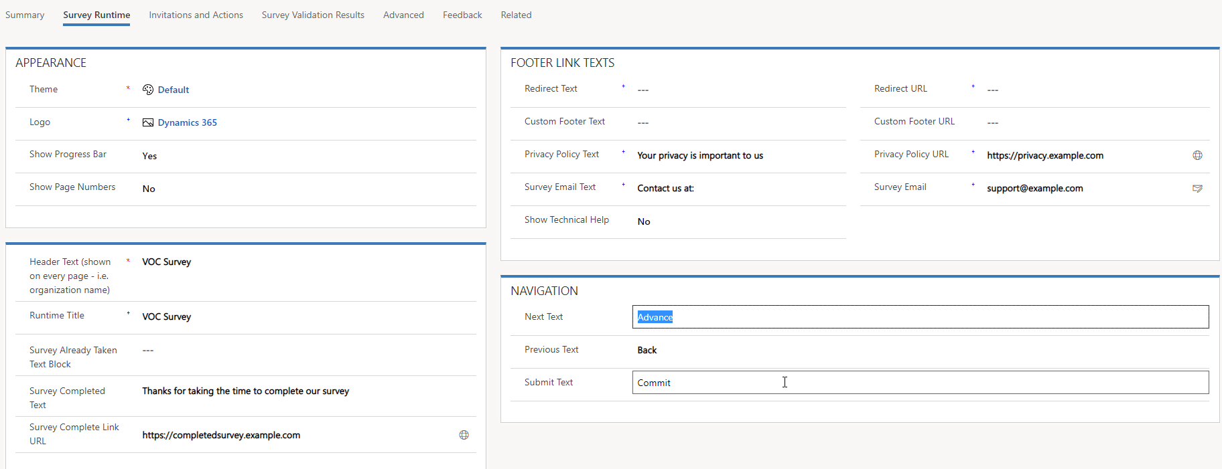
Defines the survey theme, logo, progress bar, and page number information
Defines the URL’s and text displayed in the survey’s footer.
Defines the URL’s and text displayed in the survey header
Defines the text displayed for the Next, Previous, and Submit action buttons

Slide 6
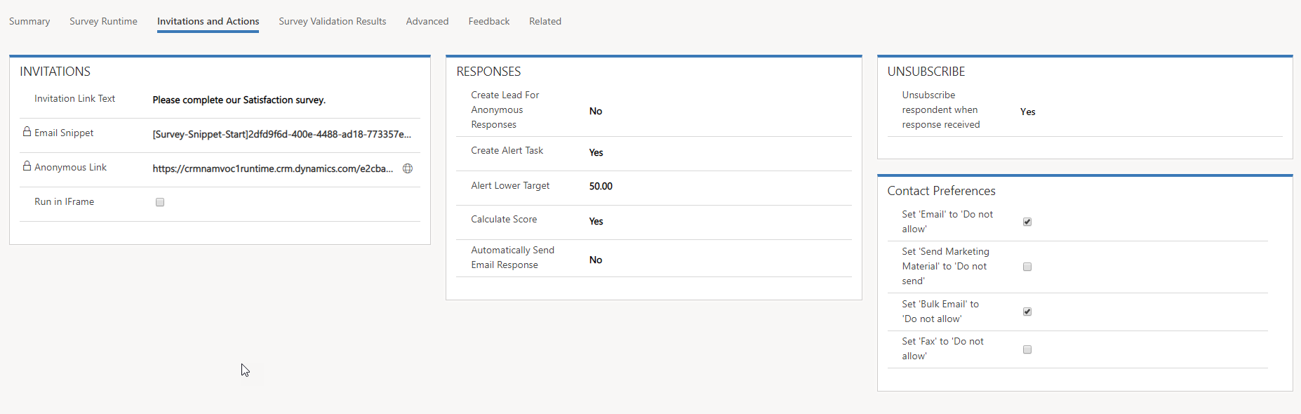
Defines survey invitation link.
Email snippet and Anonymous link are populated after the survey is published
Defines the unsubscribe actions that will be executed if a respondent unsubscribes from the survey.
Defines actions taken based on respondents overall survey score

Slide 7
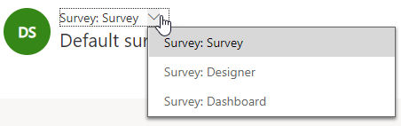

Slide 8
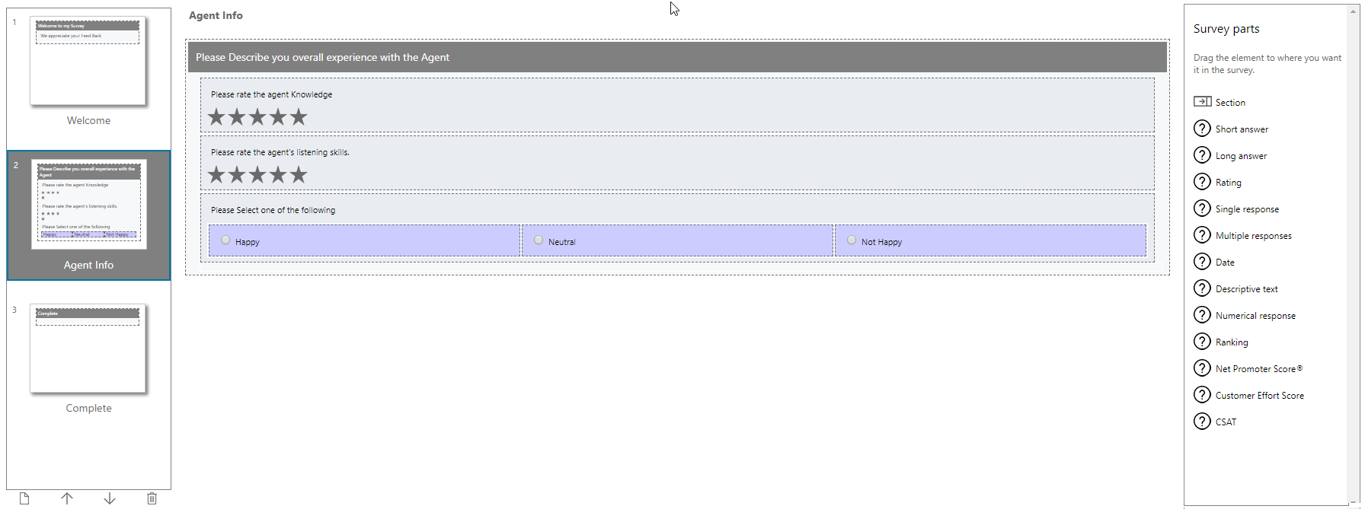
Page navigation
Survey page design area.
Available survey parts.
Survey pages can be added, moved, and deleted as needed
IMPORTANT: Each survey needs to begin with a welcome page and end with a complete page.

Slide 9
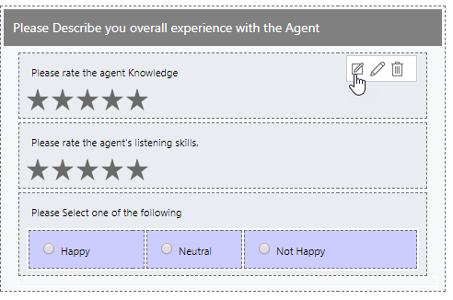
Provides access to quick edit, edit, or delete a question

Slide 10
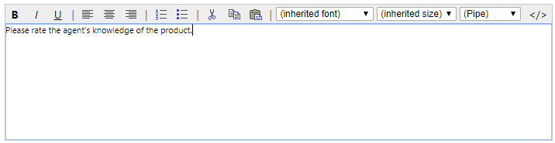
Question editor provides additional question formatting options, and options for inserting personalized data.

Slide 11
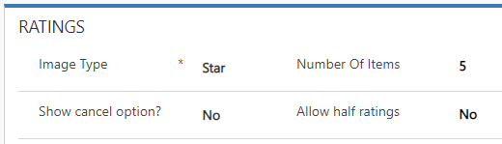
Changes the images displayed in the survey.
Controls how many stars or faces are displayed.

Slide 12




Previewing, Testing, & Publishing Surveys
Questions added
Test
Published survey
Test
Published survey
Published survey
Unpublished survey
Survey
re-published
Preview
Unpublished survey
Preview
Published survey

Slide 13
Survey - Form
Summary
Survey Runtime
Invitations and Actions
Feedback
Define Name, Unique URL, Etc.
Anonymous, Captcha, Enable Social Sharing
Unsubscribe
Define visual elements that are applied at Survey run time
Appearance, Navigation, Text, & URLS
Invitations – Distribution Links, URLs, Text, etc.
Responses –Survey Scoring, Lead creation, Alerts
Unsubscribe – Set unsubscribe behavior
Generates Feedback for a Survey in stead of Survey responses
Automatically or Manual

